Slide 1
A Nutritional Analysis of High Fructose Corn Syrup
Emily Pitts

Slide 2
History
Invented in 1966 in Japan
Became a commodity in 1977
Result of tariffs placed on sugar cane farmers to create more economical product
Corn syrup is created domestically with a variety of cost savings benefits
Longer shelf life
Retains moisture
Holds frozen foods for longer periods¹
Declared “generally safe for consumption” by Food and Drug Administration in 1976²

Slide 3
Hypothesis
Based on a comprehensive view of the subject matter, there is insufficient evidence to either support or condemn the usage of high fructose corn syrup for consumption in the food market.

Slide 4
Production Process
Corn is refined and the chemical structure is changed through an enzymatic process³
HFCS starts out as corn starch
Corn starch must then yield syrup, which is 100% glucose
This glucose is chemically alerted to change portions into fructose
This is done using enzymes like glucose isomerase
The final product:
55% fructose, 42% glucose and 3% higher sugars

Slide 5
Cause for Investigation
Increased incidence of Western disease over recent years following HFCS production
Heart disease, diabetes, liver disease, among others
Obesity epidemic
Strong link to pre-diabetes and obesity
High amounts of added sugar (including HFCS) in diet can contribute to excess calories and risk for obesity⁴
One in four Americans is obese⁵

Slide 6
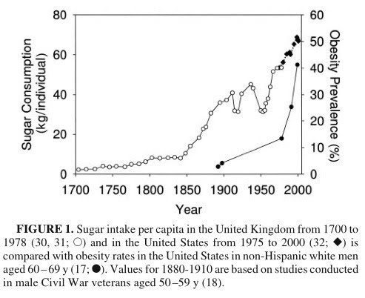
- Graph depicts obesity levels increasing steadily over time
5

Slide 7
Composition and Nutrient Density⁷
HFCS contains 79 calories, 21 carbohydrates and 7 grams of sugar per 1 ounce serving
No vitamins or minerals
No fiber
No protein or fat
6.7 grams of water
Therefore, all calories come from carbohydrates
*Sugar (sucrose) has a similar nutrient density

Slide 8
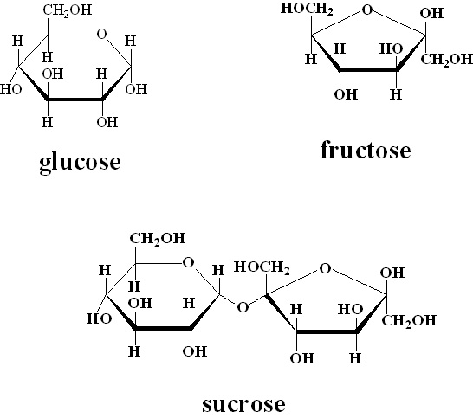

Slide 9
Corn Syrup Versus Sugar
Same caloric content in both sucrose and HFCS: 4 calories per gram³
Sucrose is a disaccharide consisting of fructose and glucose (50/50 ratio)
HFCS consists of fructose and glucose (55/45 ratio)
Fructose does not suppress hunger hormone, grehlin, which helps body recognize satiety⁸
Fructose goes through a different metabolic pathway that skips glycolysis (carbohydrate metabolism)
May not allow the body to safely regulate HFCS and sugar as energy sources

Slide 10
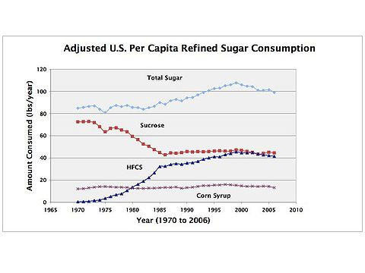
9

Slide 11
Diabetes Connection
According to the American Heart Association, “metabolic syndrome” is a pre-cursor to Type II diabetes, and may include the following factors:
Abdominal obesity
High cholesterol
High blood pressure
Insulin resistance
Proinflammitory state¹⁰
A study done on rat models concluded that fructose may contribute to insulin resistance, however, it did not specify the sources of fructose¹¹

Slide 12
Chronic Low Grade Inflammation
HFCS inflammatory factor (1 cup): -1022 (high)
The IF (Inflammation Factor) Rating™ is calculated by factoring in total antioxidants, fatty acid ratio, and glycemic index based on the food substance⁸
Chronic low grade inflammation is characterized by high levels of C-reactive protein in the blood
Has been linked to cancer and other diseases
Metabolic syndrome and CRP levels go hand-in-hand
A study at Cambridge University showed that high CRP levels may pose a risk for metabolic syndrome in women¹²

Slide 13
Heart and Liver Disease
Heart disease is the number one killer in the United States
Fructose contributes to high triglyceride levels and a excess uric acid in the body¹³
These are both known as risk factors for heart disease
Duke University Medical Center found that an increase consumption of HFCS correlates with liver scarring and disease¹⁴

Slide 14
Conclusion: Safe for Consumption?
Based on overall scientific research, evidence is inconclusive on the issue of high fructose corn syrup. Although there are many studies linking this ingredient to disease, we are unable to determine if the cause is based on HFCS alone, or the presence of fructose. Because fructose occurs in both sugar and HFCS, it may be safer to conclude that both HFCS and sugar be avoided for health benefits.

Slide 15
Suggestions for Sugar Reduction
Nutritional consultants should discuss ways to help reduce added dietary sugars with clients
Some suggestions may include:
Cutting out soda pop!
Diluting fruit juices with water
Substituting applesauce for sugar in baking
Using natural alternative sweeteners, such as Stevia
Eating more fiber, and therefore contributing to satiety, which will likely lower sugar cravings
Keeping sugar and sweets out of the household and away from easy access
Avoiding processed foods in general… And reading food labels!

Slide 16
Sources
1- "High Fructose Corn Syrup Benefits | SweetSurprise.com." High Fructose Corn Syrup Health and Diet Facts | SweetSurprise.com. Web. 29 Nov. 2010. http://www.sweetsurprise.com/learning-center/hfcs-benefits.
2 - "Database of Select Committee on GRAS Substances (SCOGS) Reviews."Accessdata.fda.gov.
http://www.accessdata.fda.gov/scripts/fcn/fcnDetailNavigation.cfm?rpt=scogsListing&id=95. Retrieved 2010-11-06.
3- "High Fructose Corn Syrup vs Sugar - Manufacturing Process | SweetSurprise.com." High Fructose Corn Syrup Health and Diet Facts | SweetSurprise.com. Corn Refiners Association. Web. 26 Nov. 2010. http://www.sweetsurprise.com/learning-center/hfcs-vs-sugar/manufacturing.
4- Nelson, Jennifer K. "What Are the Health Concerns about High-fructose Corn Syrup?" Nutrition and Healthy Eating. MayoClinic, 23 Oct. 2010. Web. 26 Nov. 2010. http://www.mayoclinic.com/health/high-fructose-corn-syrup/AN01588.
5- Sturm, R. "Increases in Morbid Obesity in the USA: 2000–2005." PubMedCentral. National Institute of Health, 05 May 2010. Web. 27 Nov. 2010. http://www.ncbi.nlm.nih.gov/pmc/articles/PMC2864630/?tool=pmcentrez.
6- Web. 28 Nov. 2010. http://eatingforliving.files.wordpress.com/2010/09/sugar-consumption-obesity-prevalence.jpg?w=493&h=402.
7- "Nutrition Facts and Analysis for Syrups, Corn, High-fructose." NutritionData.com. Self Magazine. Web. 29 Nov. 2010. http://nutritiondata.self.com/facts/sweets/5600/2.
8- Lustig, Robert H. "Sugar: The Bitter Truth." Lecture. Http://www.youtube.com/watch?v=dBnniua6-oM. Web. 28 Nov. 2010.
9- Contrast, By. "Fructose, Sugar: the Effects on Our Body FACTS! - Page 3 - David Icke's Official
Forums." David Icke Website. Web. 29 Nov. 2010. http://www.davidicke.com/forum/showthread.php?p=1058552192..
http://www.rd.com/living-healthy/lower-your-sugar-intake/article15980-2.html.
10- Metabolic Syndrome. American Heart Association. Web. 29 Nov. 2010. http://www.americanheart.org/presenter.jhtml?identifier=4756.
11- L. Ferder, M.D. Ferder, & F. Inserra (2010). The role of high-fructose corn syrup in metabolic syndrome and hypertension. 12. pp. 105-112.
12- Hans, T., N. Satter, K. Williams, C. Gonzalez-Villalpando, M. Lean, and S. Haffner. "Prospective Study of C-reactive Protein in Relation to the Development of Diabetes and Metabolic Syndrome in the Mexico City Diabetes Study." PubMed.gov. 22 Nov. 2002. Web. 29 Nov. 2010. http://www.ncbi.nlm.nih.gov/pubmed/12401749.
13- L.A.W. Parrish (2010). How does the consumption of fructose and high fructose corn syrup impact the health of children and adolescents. 6. pp. 459-460.
14- "High Fructose Corn Syrup Linked to Liver Scarring - Insciences." Insciences.org|anisation. Web. 29 Nov. 2010. http://insciences.org/article.php?article_id=8561.

