Slide 1
Parkland Students & Fictive Kin Relationships
By: Aliana Galloza, Karla Rodriguez, Nadleen Judeh
Notes:
mention briefly that the project is a qualitative ethnographic study

Slide 2
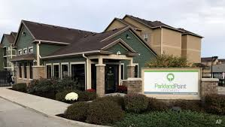
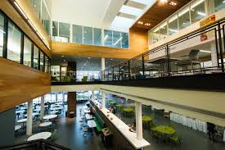
Research Hypothesis
Friendships that have begun before Parkland are stronger than those that can be made while attending community college
Notes:
Nadleen

Slide 3
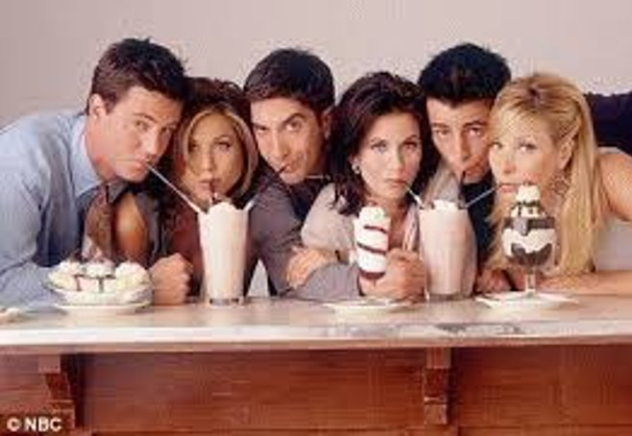
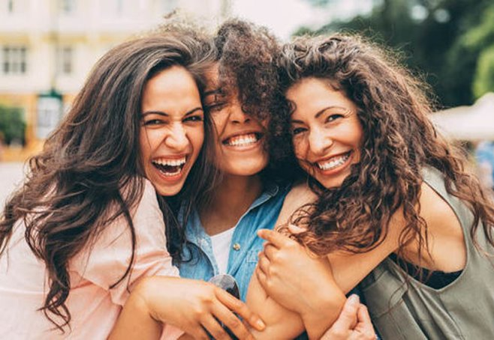
What are fictive kin relationships?
Notes:
Nadleen

Slide 4
Fictive Kin
According to Stacy Olitsky, in her article The role of fictive kinship relationships in mediating classroom competition and supporting reciprocal mentoring
“students involved in fictive kinship relationships know the details of each other’s lives and are there for each other beyond the boundaries of the classroom”
Fictive Kin- The bond between friendships that are “like family”

Slide 5
Collecting Research
Interviews & surveys

Slide 6
Interviews
Do you plan to make friends at Parkland or only finish your education?
Interviewee #1: “Yes to make connections. Hopefully to stay connected afterwards, but I am not planning to stay here after graduation. I still want to create something to look back to”
Were your friends made at Parkland or from before coming to school here?
Interviewee #2: “Prior to coming to school here. I don’t think I have friends I’ve made at Parkland: not close ones at least.”
Do you have friends that you consider family? How did you meet them?
Interviewee #3: “My best friends and I met in high school and live with right now. They sure seem on the level that I’ll know them forever and do just about anything for them as I would for my brother or mother.”
Notes:
everyone

Slide 7
Survey Results
9 Responses
Google Forms
Notes:
"since the interviews didn't provide as much information as we expected, we surveyed 9 additional people with similar questions on fictive kin at Parkland."

Slide 8
Do you plan to also make friends at Parkland or only finish your education?
Where have you met your friends during your time as a student at Parkland College?

Slide 9
Does your best friend also go to Parkland?
Do you have friends who are close to you that you feel are family?

Slide 10
Question Responses
How did you meet your friends?
High School
Class at Parkland
Workplace
University of Illinois at Urbana Champaign (U of I)

Slide 11
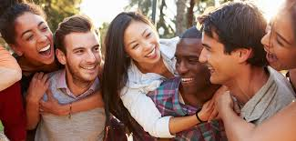
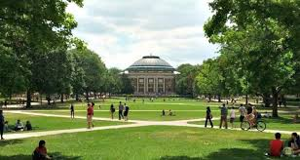
Conclusion
Fictive kin relationships are being built outside of Parkland
Students are meeting their friends at UIUC, high school, as well as at the Parkland campus
Students want to build more connections as they continue their education.

