Slide 1
Notes:
Erika

Slide 2
What is scholarship at a community college?
What is scholarship at Parkland?
Discovery of scholarly and creative work
Boyer’s Paradigm of Scholarship
Innovation Funds support
Notes:
Erika

Slide 3
Boyer’s Paradigm of Scholarship
Discovery
Integration
Application/ Engagement
Teaching and Learning
Notes:
Erika

Slide 4
Why not just a website?
Increased findability
Increased accessibility
Automated reporting
What materials can be included?
Scholarly and creative work of students, faculty and staff
Video, audio, text, animation, images
Notes:
Sherry

Slide 5
Innovative solution to institutional needs
Showcases, collocates and preserves co-curricular work
Unique for community colleges
Partnership model brings greater buy-in, content and context
Notes:
Sherry

Slide 6
Supporting Student Success
Creates a visible picture and deeper understanding of student success; alignment with the institution and academic community (Kuh, George, et al. Student Success in College: Creating Conditions that Matter. 2005)
Visibility and institutional branding of work for future educational institutions and employers
Notes:
Erika

Slide 7
Benefits for the institution and community
Captures the intellectual capital of the college
Preserves the intellectual memory of the college
Increases institutional visibility locally and globally
Facilitates the growth of scholarly and creative work for students, faculty and staff
Notes:
Erika

Slide 8
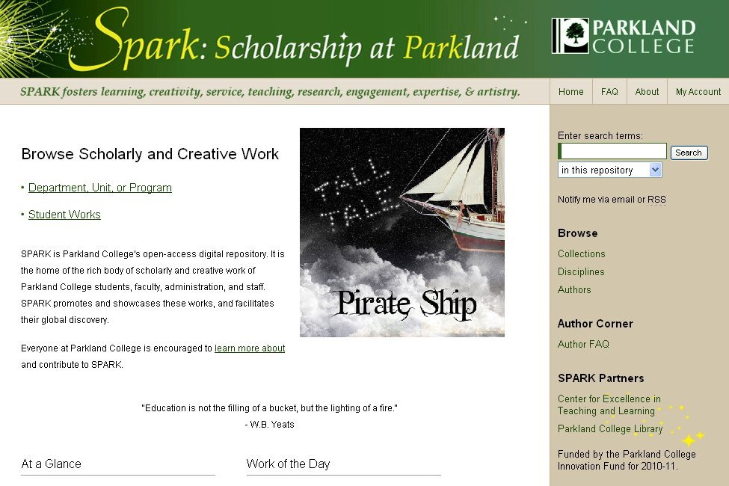

Slide 11
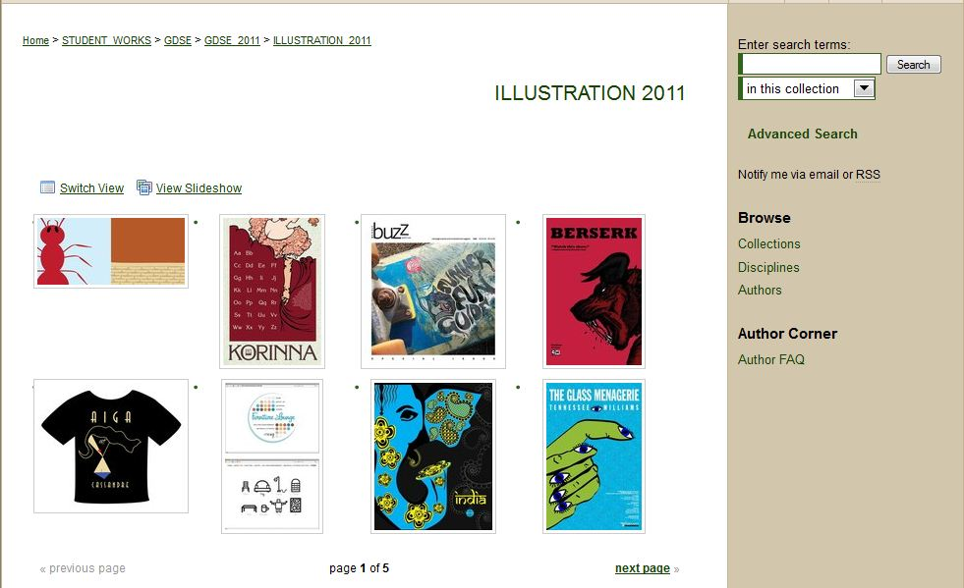

Slide 12
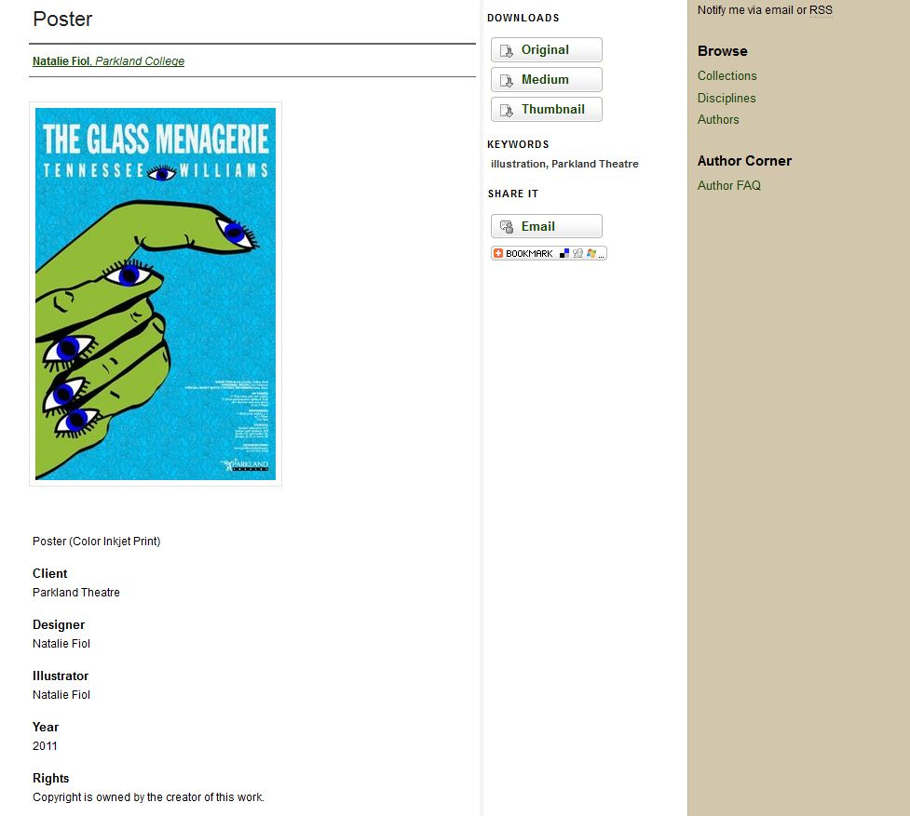

Slide 13
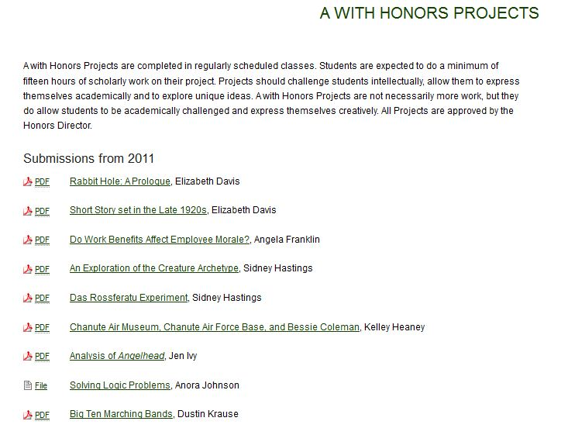

Slide 15
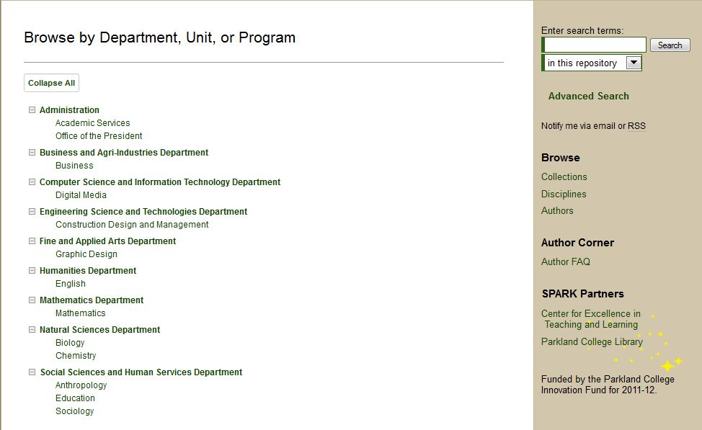

Slide 17
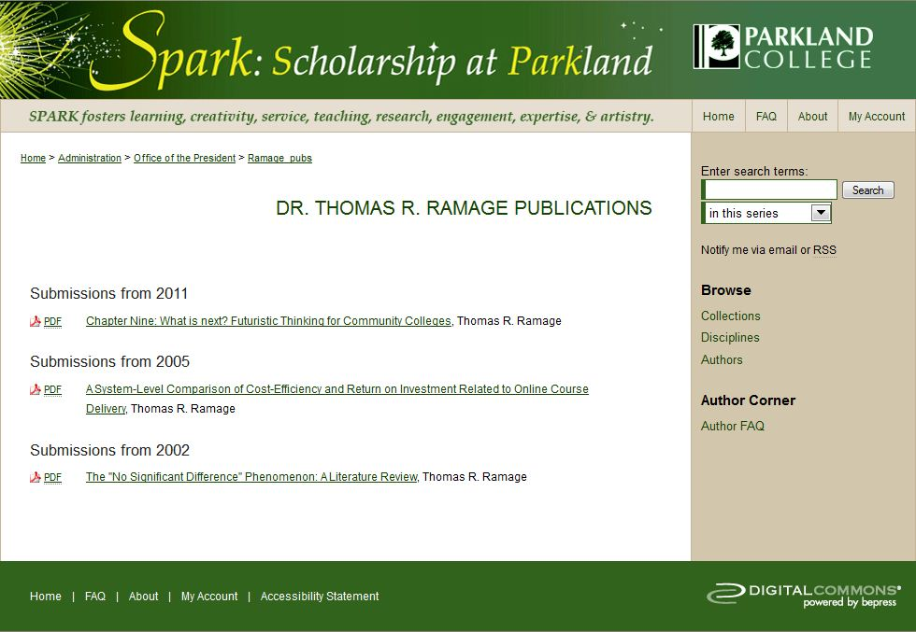

Slide 18
Evaluation and Impact
Benchmarks each semester
State and national recognition
Mentoring other community colleges in developing IRs
Notes:
Sherry

Slide 19
Replicability
Tie IR goals to institutional mission and strategic goals
Go where the energy is
Strong co-managers
Service model: Do It For You
Talk, talk, talk….foster a dialogue
Find faculty champions
Notes:
Sherry

Slide 20
Resources Needed
Human
Financial
Training and development
Policies
Scope
Copyright
Notes:
Sherry

Slide 21
Future Directions…
Continue building student collections
Expand collections of scholarly and creative work of faculty and staff
Conference papers/presentations, articles, essays
Continue to lead and develop conversation about the role of scholarship at community colleges
Notes:
Erika

Slide 22
Resources
Boyer, E. L. (1990). Scholarship reconsidered: Priorities of the professoriate. Princeton, N.J: Carnegie Foundation for the Advancement of Teaching.
Kuh, G. D., et al. Documenting Effective Educational Practice (Project). (2005). Student success in college: Creating conditions that matter. San Francisco: Jossey-Bass.
Nabe, J.A. (2010). Starting, strengthening and managing institutional repositories: a how-to-do-it-manual. New York: Neal-Schuman Publishers.
ACRL Scholarly Communication Toolkit
http://scholcomm.acrl.ala.org/
C&RL Scholarly Communication columns
http://www.ala.org/acrl/issues/scholcomm/scholcommcolumn

Slide 23
Thank You!
Sherry Cmiel
scmiel@parkland.edu
Erika Hackman
ehackman@parkland.edu

